Slide 1
Hierarchical Clustering
Coursera – week3
July, 2021

Slide 2
Clustering organizes things that are close into groups.
How do we define close?
How do we group things?
How do we visualize the grouping?
How do we interpret the grouping?

Slide 3
An agglomerative approach
Find closest two things
Put them together
Find the next closes
Requires
A defined distance
A merging approach
Produces
A tree (dendogram) showing how close things are to each other.

Slide 4
An agglomerative approach
Find closest two things
Put them together
Find the next closes
Requires
A defined distance
A merging approach
Produces
A tree (dendrogram) showing how close things are to each other.

Slide 5
How do we define close?
Most important step:
Garbage in -> garbage out
Distance or similarity:
Continuous – eucleadian distance
Continuous – correlation similarity
Binary – manhattan distance
Pick a distance/similarity that makes sense for your problem.

Slide 6


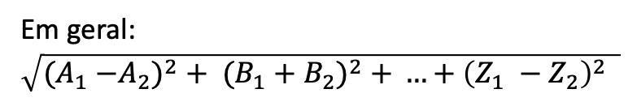



Euclidean distance
Baltimore $(X_{2}, Y_{2})$
$$\sqrt{{{(X}_{1} −{ X}_{2})}^{2}+{\left(Y_{1} −Y_{2}\right)}^{2} }$$
$$Y_{1} −Y_{2}$$
DC $(X_{1}, Y_{1})$
Em geral: $\sqrt{{{(A}_{1} −A_{2})}^{2}+ {(B_{1}+B_{2})}^{2} + …+{\left(Z_{1} −Z_{2}\right)}^{2} }$
$$X_{1} −X_{2}$$

Slide 7
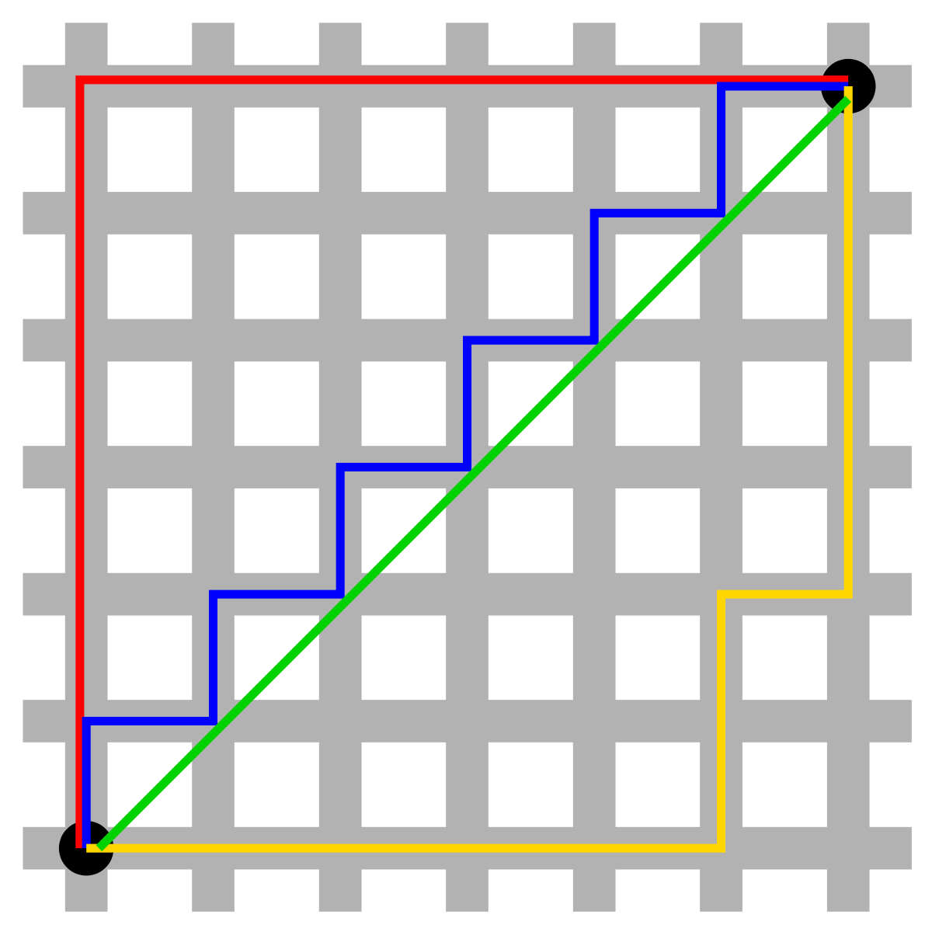
Manhattam distance
$Em geral \left|A_{1} −A_{2}\right|+|B_{1} −B_{2}|$ $+ …+ |Z_{1} −Z_{2}$|

Slide 8
References and links
http://rafalab.github.io/pages/teaching.html
https://rafalab.github.io/dsbook/

